Slide 1
Numerical Calculations of Finite Key Rate for General Quantum Key Distribution Protocols
Ian George, Jie Lin, Norbert LÜTkenhaus
arXiv:2004.11865
Notes:
Note

Slide 2
Motivation
People are now trying to implement quantum key distribution (QKD) protocols for industry use.
A
B
Handling side channels and practical issues in implementations with respect to finite size behavior is more important than ever

Slide 3
Motivation
Problem:
Tight finite key analysis analytically needs symmetries
Many QKD protocols lack these symmetries
Solution: A numerical method that doesn’t need the symmetries.
Uses Renner’s framework [1]
Extends numerical method of [3]
[1] R. Renner. Int. J. Quantum Inf. 06, 1 (2008)
[3] A. Winick, N. Lütkenhaus, P. Coles. Quantum 2, 77 (2018)

Slide 4
Overview
Renner Finite Size Security Framework
Extension of Numerical Method to Finite Size
Examples of Our Numerical Method
Notes:
Note

Slide 5
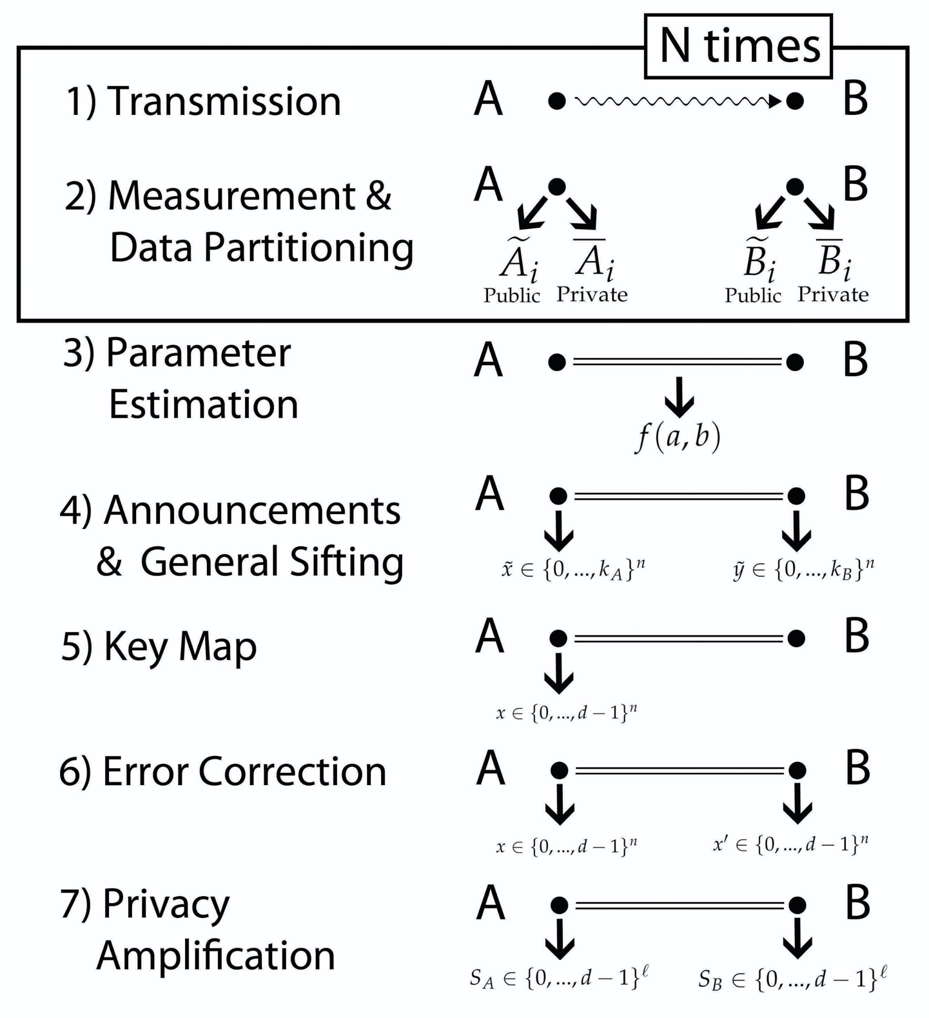
General (Device-Dependent) QKD Protocol
Notes:
Note

Slide 6
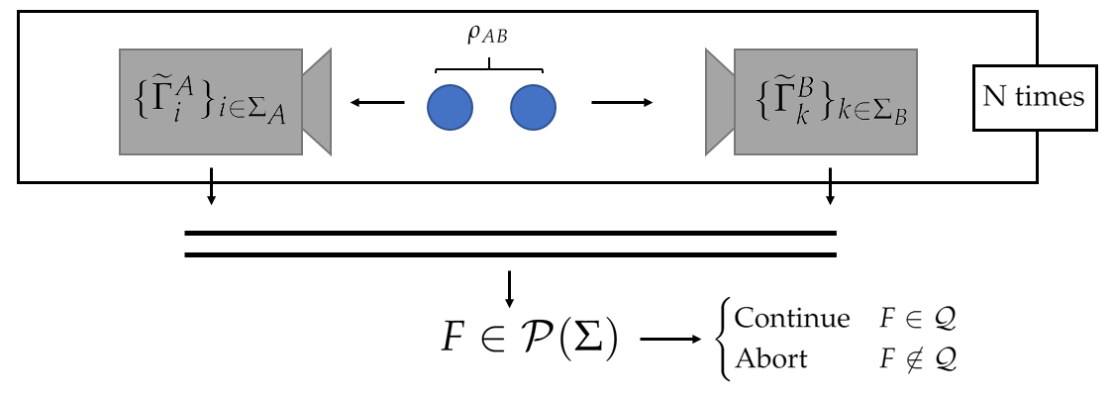
Parameter Estimation
A parameter estimation subprotocol is a CPTNI map of the form:
$$Φ_{PE}:{\left(A⊗B\right)}^{⊗m}→\left[Abort, Pass\right]≅[0,1]$$
$$→Φ_{PE}\left(ρ\right)=\operatorname{Pr}\left[Pass | Input=ρ\right]$$

Slide 7
Coarse-Graining Data

Slide 8
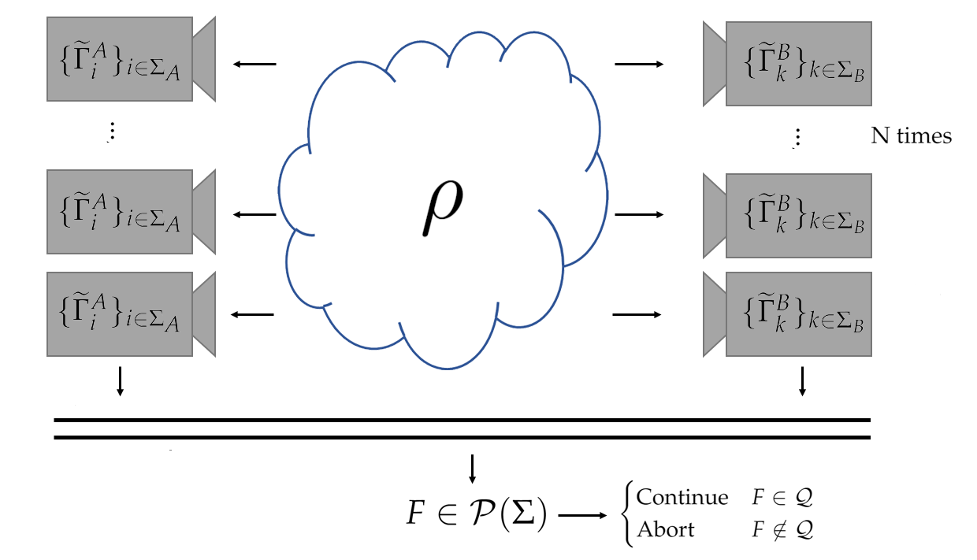
$ε_{PE}$-Securely Filtered States
A state $ρ$ is $ε_{PE}$-securely filtered if and only if
$$Φ_{PE}\left(ρ\right)=\operatorname{Pr}\left[Pass | Input=ρ\right]≤ε_{PE}$$

Slide 9
The Set of $ε$-Securely Filtered States
Use Structure of Device-Dependent QKD:
• Known POVM ${\left\{{\tilde{Γ}}_{j}\right\}}_{j∈Σ}$ • Statistics $F$ • Acceptance Set $𝒬$

Slide 10
The Set of $ε$-Securely Filtered States
Assuming i.i.d. $σ^{⊗m}$ input, by law of large numbers:
where $𝒬$ is the acceptance set and is the measurement channel of the joint POVM.

Slide 11
Tightening the Set
The set is not optimal:
$$μ=\sqrt{2} \sqrt{\left(\ln{ε_{PE}^{−1}}+\left|Σ\right|\ln{m+1}\right)/m}$$
For two-outcome POVM, Hoeffding inequality tightens the bound
Coarse-graining can improve the bound in some cases
Problem: Throwing out information helps Alice and Bob be more secure?
Of course not!

Slide 12
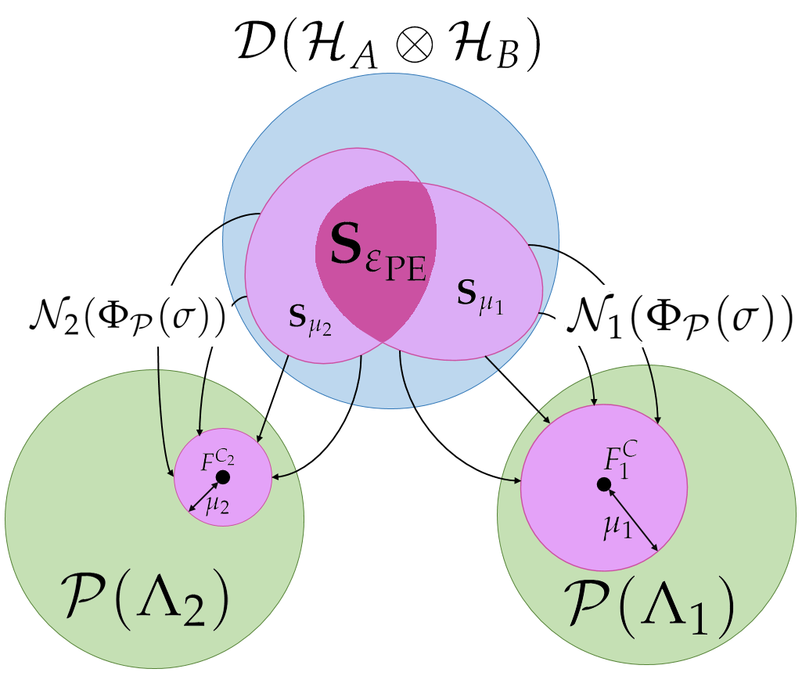
Multiple Coarse-Grainings Pictorially
Assumes $𝒬=\{q\}$

Slide 13
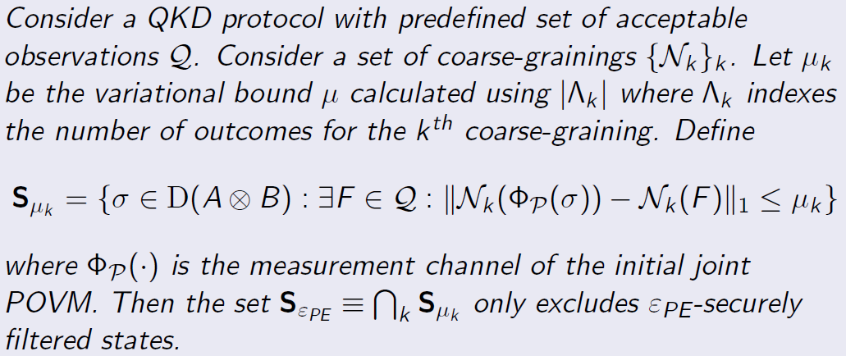
Multiple Coarse-Grainings

Slide 14
Overview
Renner Finite Size Security Framework
Extension of Numerical Method to Finite Size
Examples of Our Numerical Method
Notes:
Note

Slide 15
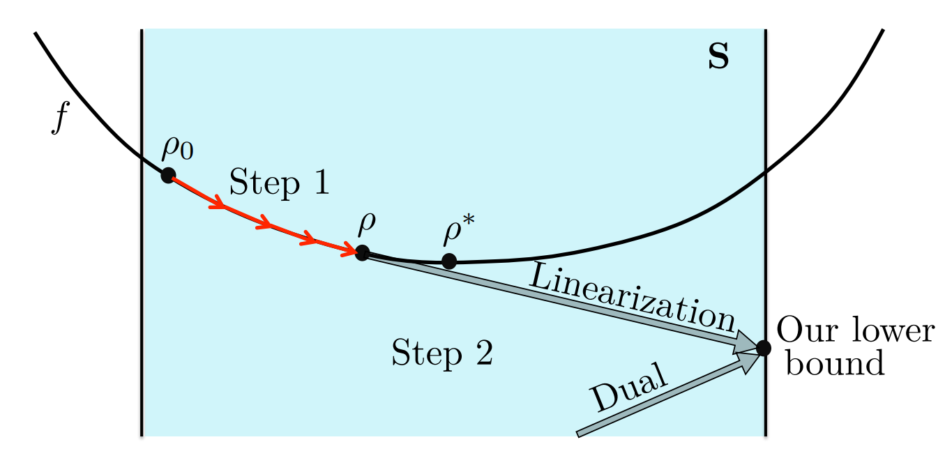
Asymptotic Key Rate Algorithm [3]
Asymptotic Key Rate:
$R_{∞}=$ $\min_{ρ∈S}{H{\left(X | E\right)}_{ρ}}$ $−f_{EC}H(X|Y)$
[3] A. Winick, N. Lütkenhaus, P. Coles. Quantum 2, 77 (2018)

Slide 16
Key Length Calculation
Let $ε_{PE}, \overline{ε},ε_{EC},ε_{PA}>0$. Assuming i.i.d. attack, the QKD protocol is $ε=ε_{PE}+\overline{ε}+ε_{EC}+ε_{PA}$-secure given that, when the protocol does not abort, the output key is of length $ℓ$ where:
$$ℓ≤n\left(H_{μ}(X|E)−δ\left(\overline{ε}\right)\right)−{leak}_{ε_{EC}} −2\log_{2}{(1/ε_{PA})}$$
With the following definitions:
$$H_{μ}(X|E)=\min_{ρ∈S_{ε_{PE}}}{H{\left(X | E\right)}_{ρ}}$$
$${leak}_{ε_{EC}}=n f_{EC} H\left(X | Y\right)+\log_{2}{(2/ε_{EC})}$$
$$δ\left(\overline{ε}\right)=2\log_{2}{(d+3)}\sqrt{\log_{2}{(2/\overline{ε})/n}}$$

Slide 17
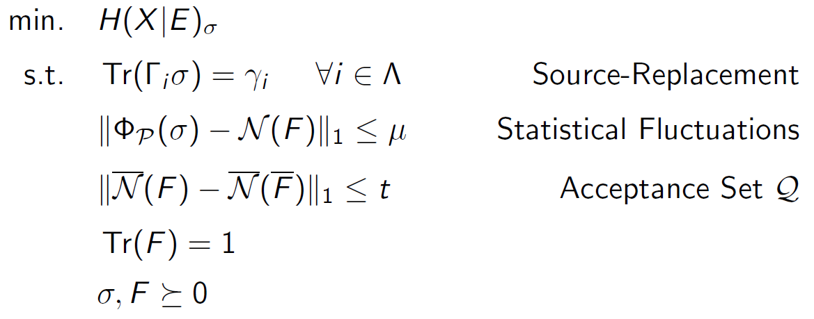
SDP for $H_{μ}(X|E)$
Requires the assumption:

Slide 18
Numerical Coherent Attack Analysis
Finite Quantum de Finetti Theorem [1]:
Increases the size of variational distance $μ$
Adds corrections terms
Post-Selection Technique [4]:
If $ε$-secure on collective attack, ${\left(N+1\right)}^{d_{AB}^{2}−1}ε$-secure on coherent attack
$⇒$ Calculate the collective attack with the security parameters divided by ${\left(N+1\right)}^{d_{AB}^{2}−1}$ to get the coherent attack key rate¹
Take-away: Solver is for both coherent and collective attack analysis
[1] R. Renner. Int. J. Quantum Inf. 06, 1 (2008)
[4] M. Christandl, R. König, R. Renner. Phys. Rev. Lett. 102, 020504 (2009)
[5] N. J. Beaudry. Assumptions in Quantum Cryptography. PhD Thesis. arxiv:1505.02792

Slide 19
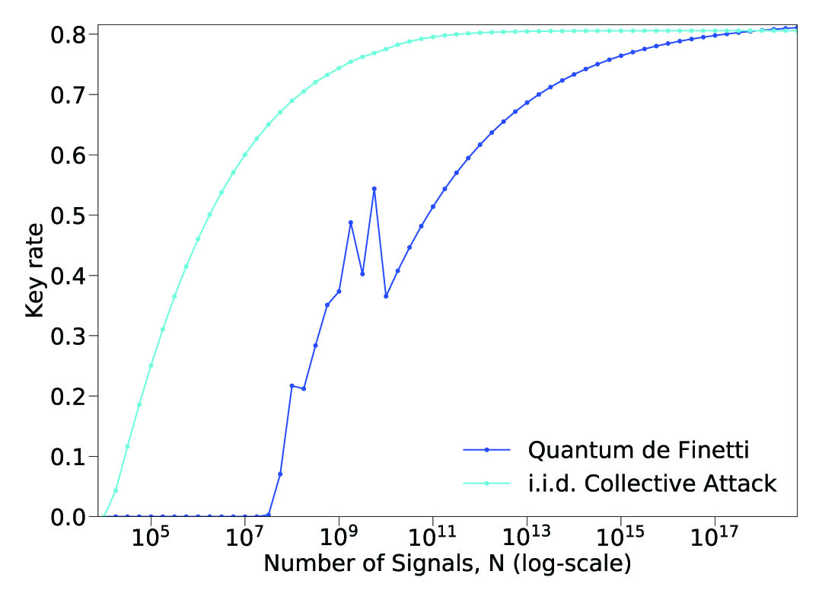
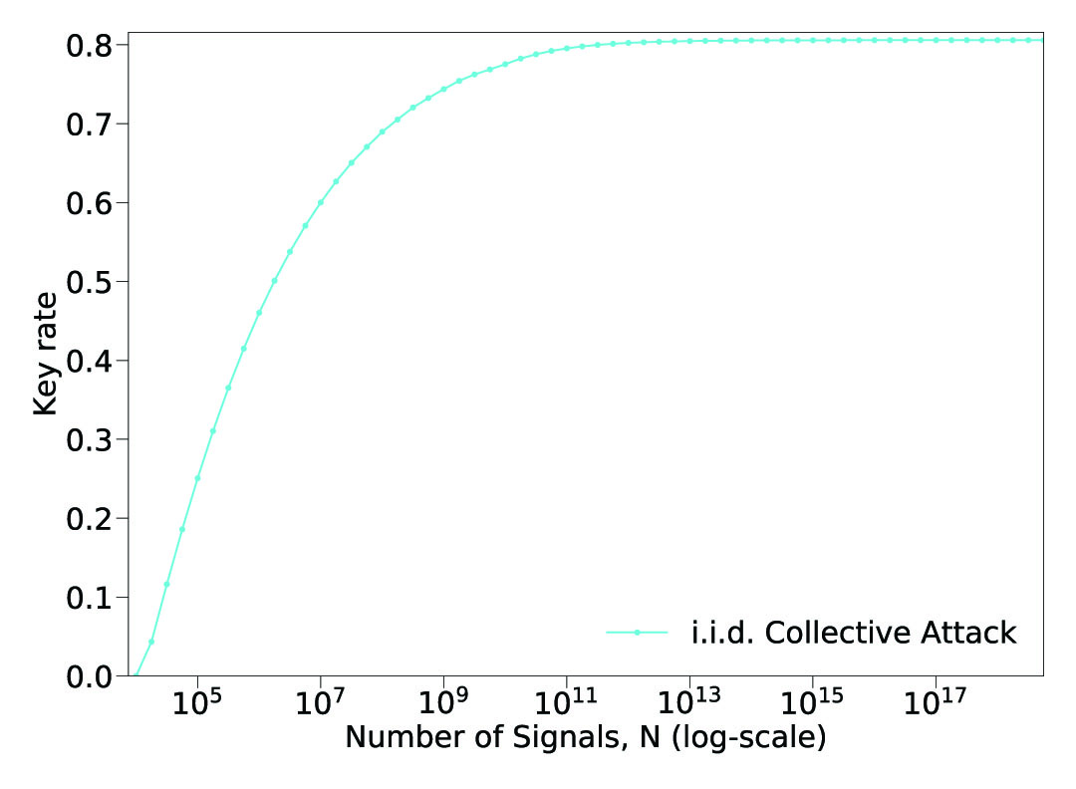
Analytic Coherent Analysis of BB84
Coherent attack analysis of BB84 considering only phase error statistics and accepting only the ideal observations. Analytic result.

Slide 20
Overview
Renner Finite Size Security Framework
Extension of Numerical Method to Finite Size
Examples of Our Numerical Method
Notes:
Note

Slide 21
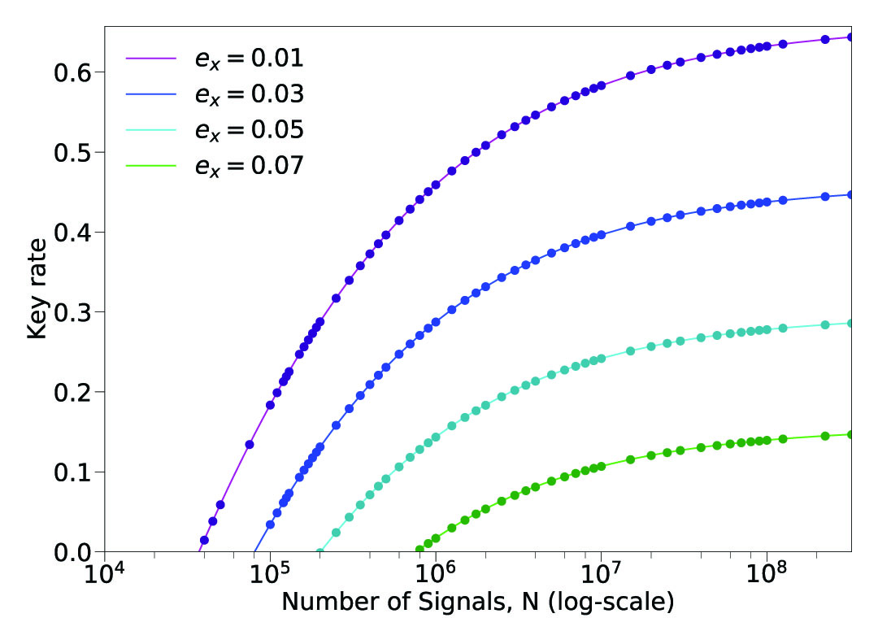
Comparison to Analytic Results
We see that for a simple analytical case as was considered in [6], our results achieve that of the analytic results.
Figure: Phase Error BB84. Numerical results (dots) versus analytic results (lines).
[6] V. Scarani, R. Renner. Phys. Rev. Lett. 100, 200501 (2008)

Slide 22
Reference Frame Misaligned BB84
Alice’s Signals
What Bob Receives
$$Z$$
$$Z$$
$$Z$$
$$X$$
Channel
$$X$$
$$X$$
$$Y$$
$$Y$$
+ Sufficient Parameter Estimation
$$Y$$

Slide 23
Reference Frame Misaligned BB84
When the channel Alice sends signals has a simple noise model, coarse-grained data is sufficient:
 | “0” | “1” | “+” | “-”
“0” | 0.1225 | 0.0025 | 0.0625 | 0.0625
“1” | 0.0025 | 0.1225 | 0.0625 | 0.0625
“+” | 0.0625 | 0.0625 | 0.1225 | 0.0025
“-” | 0.0625 | 0.0625 | 0.0025 | 0.1225
Figure: Joint probability distribution for 2% qubit error rate in symmetric case

Slide 24
Reference Frame Misaligned BB84
However, this is not the case in general. For example, if a unitary rotation about the Y-axis is applied after the noise:
 | “0” | “1” | “+” | “-”
“0” | 0.1173 | 0.0077 | 0.0381 | 0.08691
“1” | 0.0077 | 0.1173 | 0.08691 | 0.0381
“+” | 0.08691 | 0.0381 | 0.1173 | 0.0077
“-” | 0.0381 | 0.08691 | 0.0077 | 0.1173
Figure: Joint probability distribution for 2% qubit error rate after misalignment

Slide 25
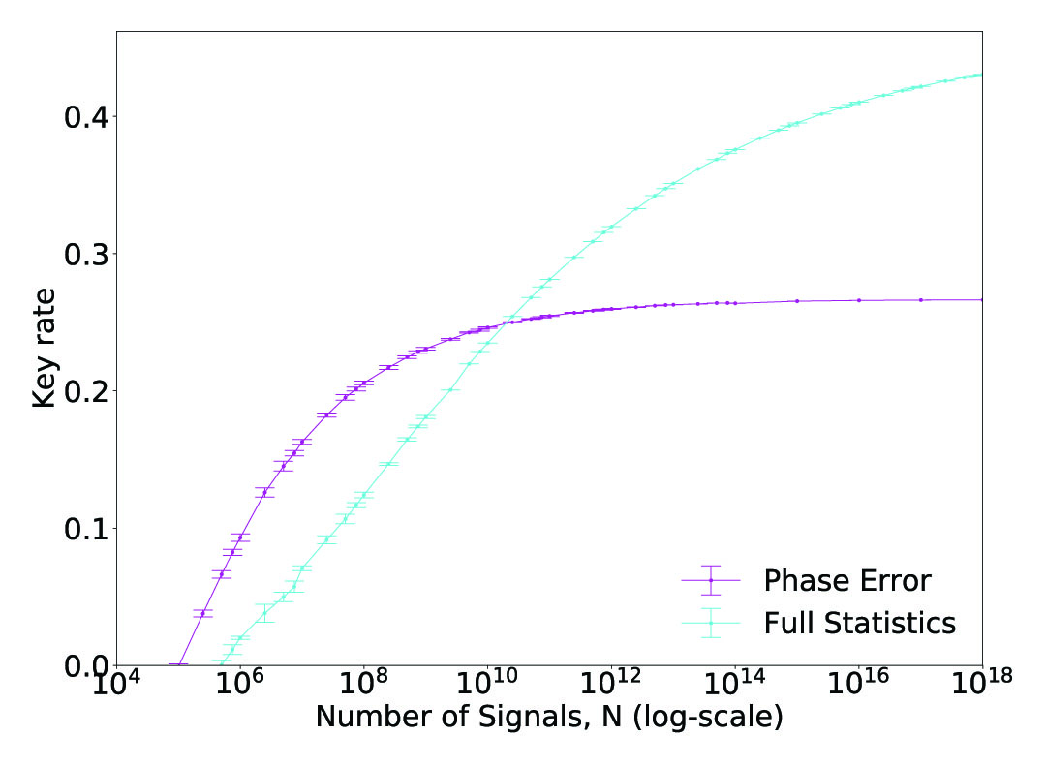
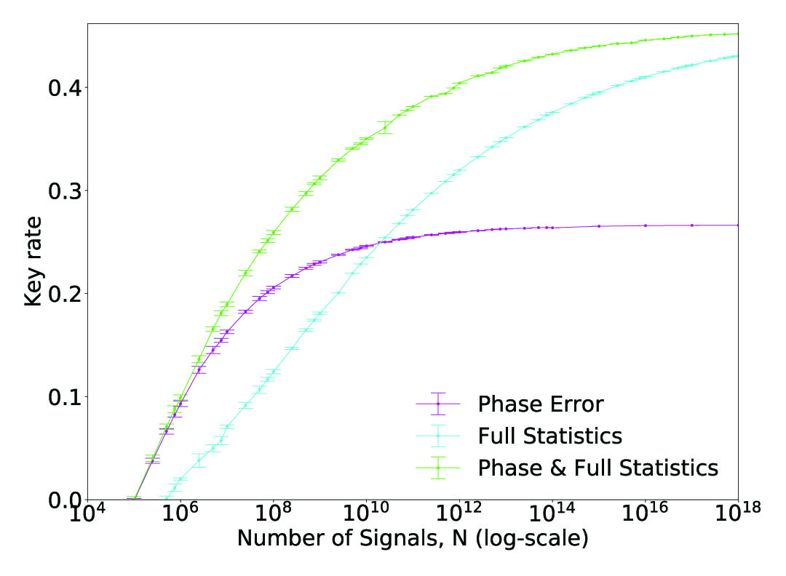
Reference Frame Misaligned BB84
Figure: Reference frame misaligned BB84 for different choices of coarse-graining and considering multiple coarse-grainings.

Slide 26
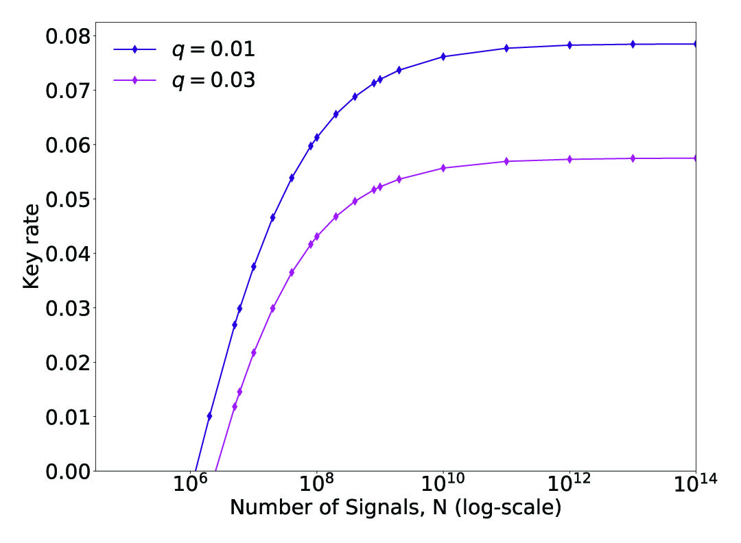
Qubit MDI QKD Protocol
The only change for MDI-QKD protocols is that the joint probability distribution is over Alice, Bob, and Charlie’s observations.
Figure: Qubit MDI BB84 with equal basis choice and a dephasing channel applied to both Alice and Bob's signal state sent to Charlie. Fine-grained statistics are used to calculate the variatonal bound $μ$.

Slide 27
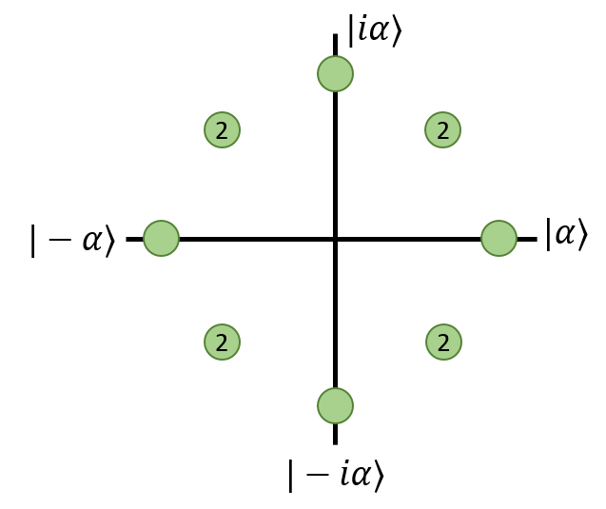
Discrete-Phase-Randomized BB84
If there exists a squashing model, our numerical method can determine the key rate for optically implemented QKD protocols.
Here we consider Discrete-Phase-Randomized BB84 [7]:
[7] Z. Cao, Z. Zhang, H.-K. Lo, and X. Ma. New J. Phys. 17, 053014 (2015)

Slide 28
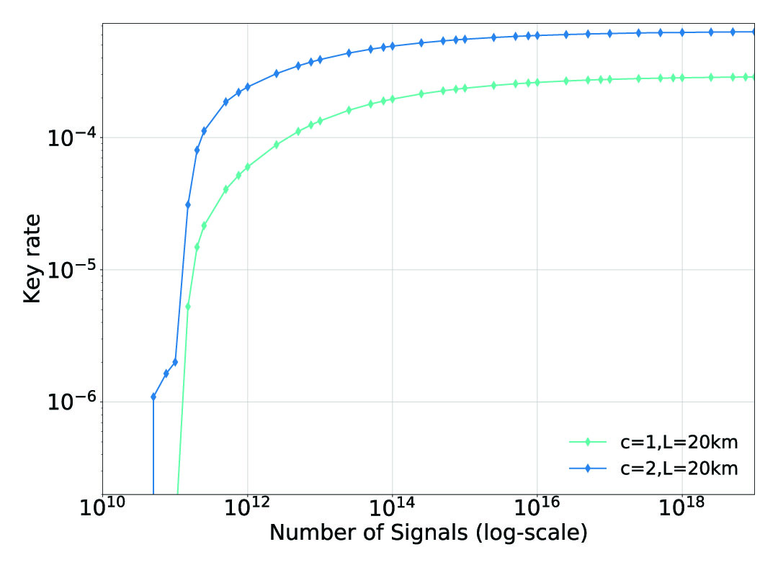
Discrete-Phase-Randomized BB84
Figure: Key rate of DPR BB84 for 1 and 2 discrete phases for two different distances.

Slide 29
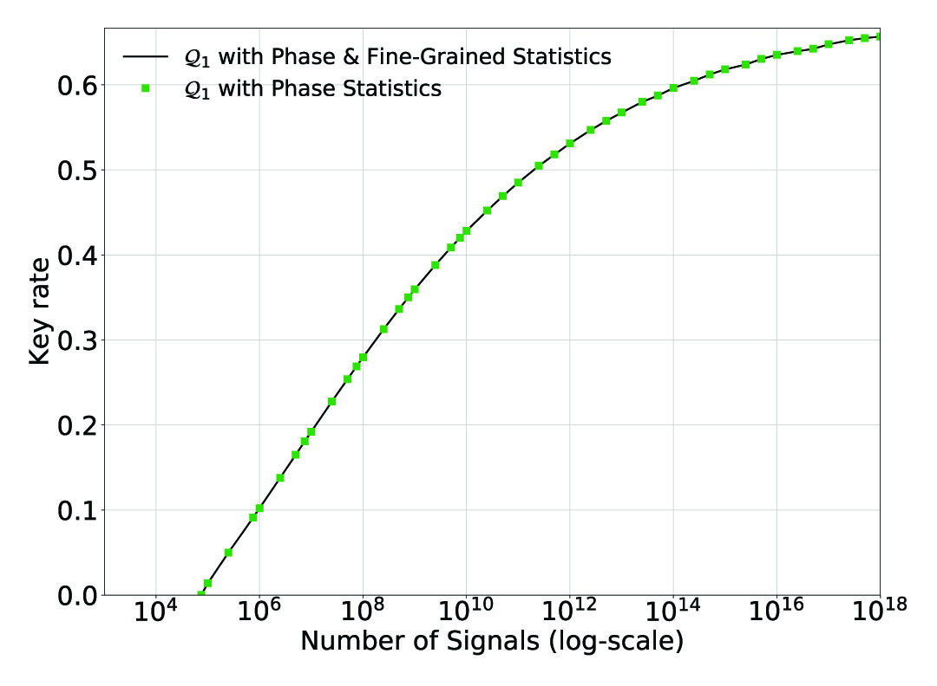
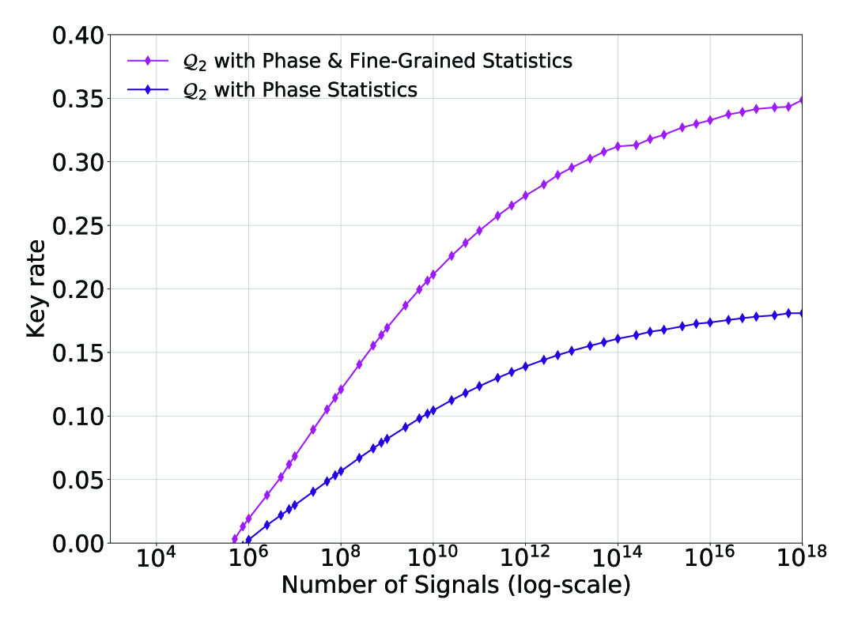
Practical Acceptance Set $𝒬$
It is impractical to only accept a frequency distribution $F$ with a limited number of signals for parameter estimation – need a practical set of distributions to accept on.
(Right) Key rate of the BB84 protocol for accepting observed statistics suffering from reference frame misalignment, $𝒬_{2}$.
Figure: (Left) Key rate of the BB84 protocol for accepting statistics in $𝒬_{1}$ which just considers phase error.

Slide 30
Summary
Improved the analysis of the parameter estimation subprotocol
Constructed a general numerical solver for determining the finite key rate of QKD protocol represented in finite-dimensional Hilbert spaces
Generality in types of protocols (qubit protocols, qubit MDI protocols, protocols with squashing models)
Generality in practicality by considering acceptance set $𝒬$
Considered when our improved parameter estimation analysis may be advantageous (asymmetric observations)
Could be useful for investigating side channels in the finite regime

Slide 31
Thank You!
References:
[1] R. Renner. Int. J. Quantum Inf. 06, 1 (2008)
[2] I. George, J. Lin, N. Lütkenhaus. arxiv:2004.11865
[3] A. Winick, N. Lütkenhaus, P. Coles. Quantum 2, 77 (2018)
[4] M. Christandl, R. König, R. Renner. Phys. Rev. Lett. 102, 020504 (2009)
[5] N. J. Beaudry. Assumptions in Quantum Cryptography. PhD Thesis. arxiv:1505.02792
[6] V. Scarani, R. Renner. Phys. Rev. Lett. 100, 200501 (2008)
[7] Z. Cao, Z. Zhang, H.-K. Lo, and X. Ma. New J. Phys. 17, 053014 (2015)

